Slide 1
PROJECT TITLE
Efficient Doctor Patient Portal

Slide 2

Group Members
Name | College Name | Registration Number
Abhinav Kumar Maurya | Budge Budge Institute Of Technology | 1427600110001
Astuti prashar | Budge Budge Institute Of Technology | 142760110012
Priti Shreya | Budge Budge Institute Of Technology | 142760110030
Kriti Kumari | Budge Budge Institute Of Technology | 142760110026

Slide 3

Table Of Contents
Acknowledgement
Project Objective
Project Scope
Requirement Specification
Database Design
Screenshots
Future Scope of Improvements
Codes
Certificate

Slide 4

ACKNOWLEDGEMENT
I take this opportunity to express my profound gratitude and deep regards to my faculty
(Dr. Bimal Kumar Dutta) for his exemplary guidance, monitoring and constant encouragement throughout the course of this project. The blessing, help and guidance given by him/her time to time shall carry me a long way in the journey of life on which I am about to embark. I am obliged to my project team members for the valuable information provided by them in their respective fields. I am grateful for their cooperation during the period of my assignment.

Slide 5

Project Objective
Advantages of ONECLICK:
* This Website is very user friendly.
* It helps each and every patient to have their appointments booked or removed just with a single ONECLICK.
* One can easily view the doctor list just with ONECLICK
* Easily accessing doctors database and choosing doctor by ONECLICK

Slide 6

Project Scope
This Website would help every patient to easily access to the website.
With this website it helps any patient to appoint their desired doctor just with ONECLICK
One can see the availability of each and every doctor of their choice with a ONECLICK
One can easily view the doctor list just with ONECLICK

Slide 7

Requirement Specification
Coding language: PHP
Database: SQL
Database Server: Mysql
Server: Javascript
Images: JPEG,GIF

Slide 8
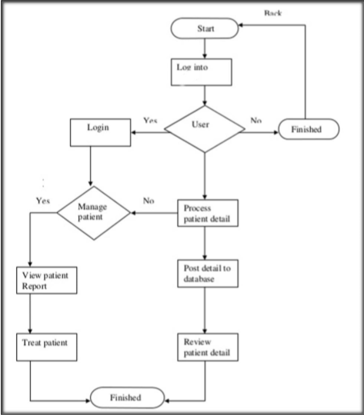
Logical Model

Slide 9
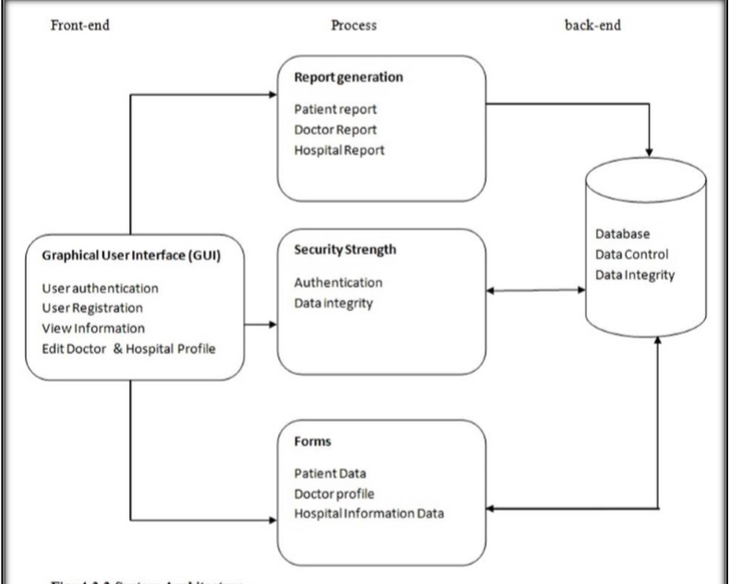
System Architecture

Slide 10
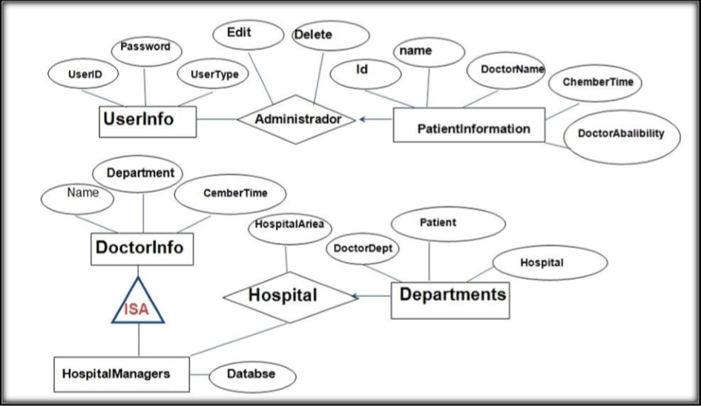
ERD Diagram

Slide 11
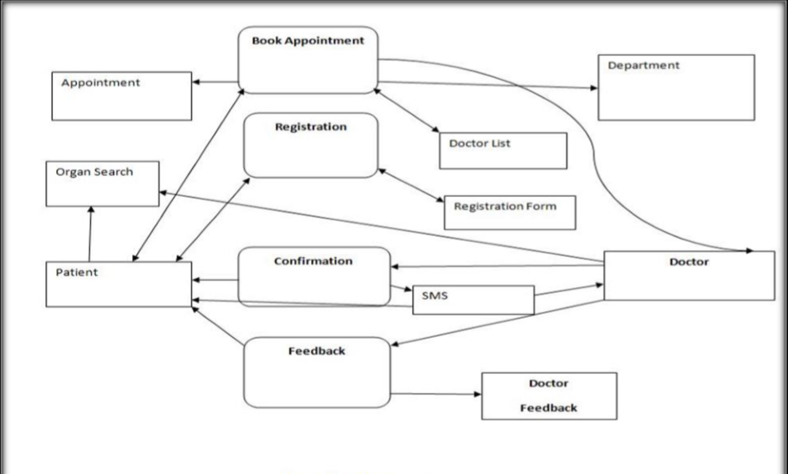
DFD Diagram

Slide 12
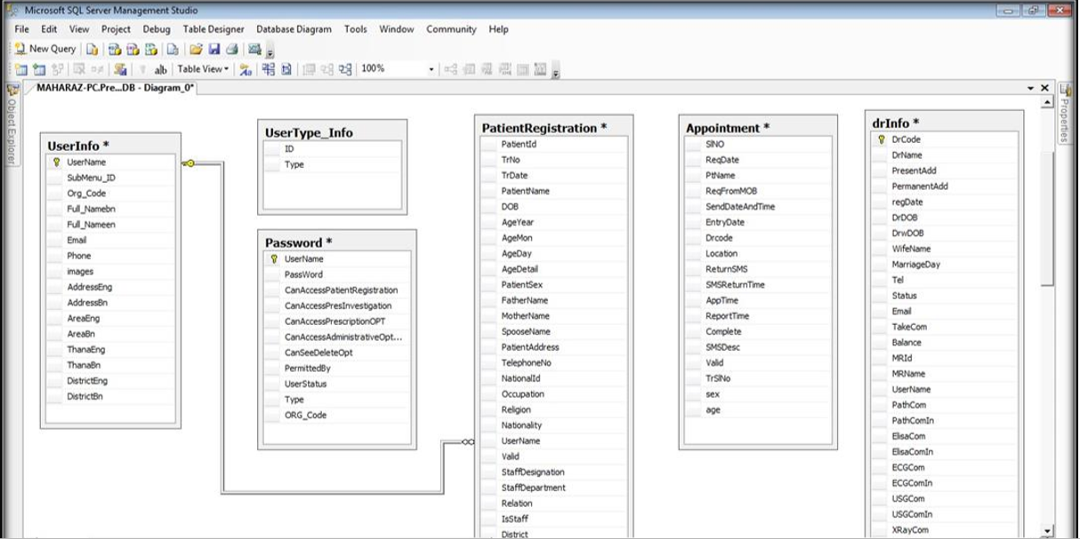
Database Diagram

Slide 13

SCREENSHOTS

Slide 14
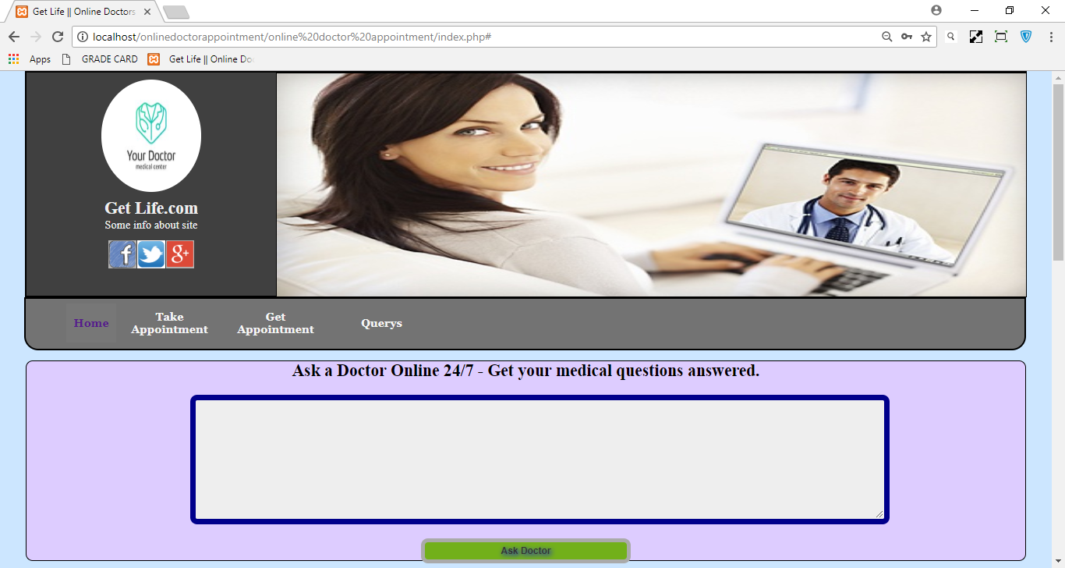

Slide 15
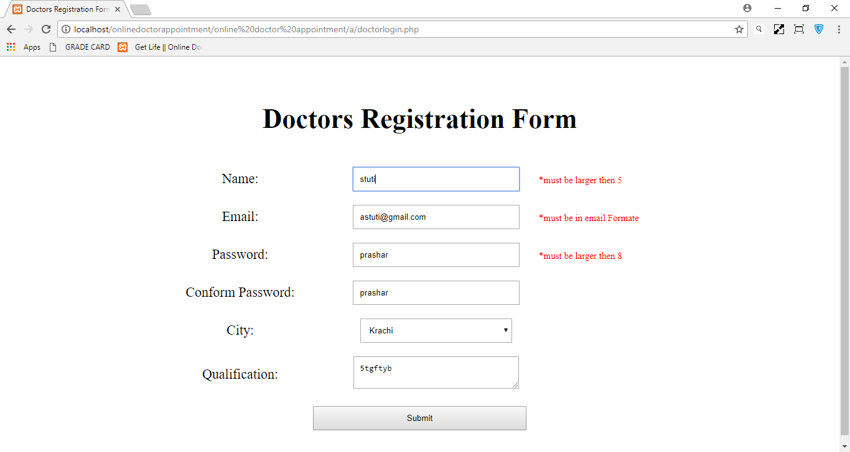

Slide 16
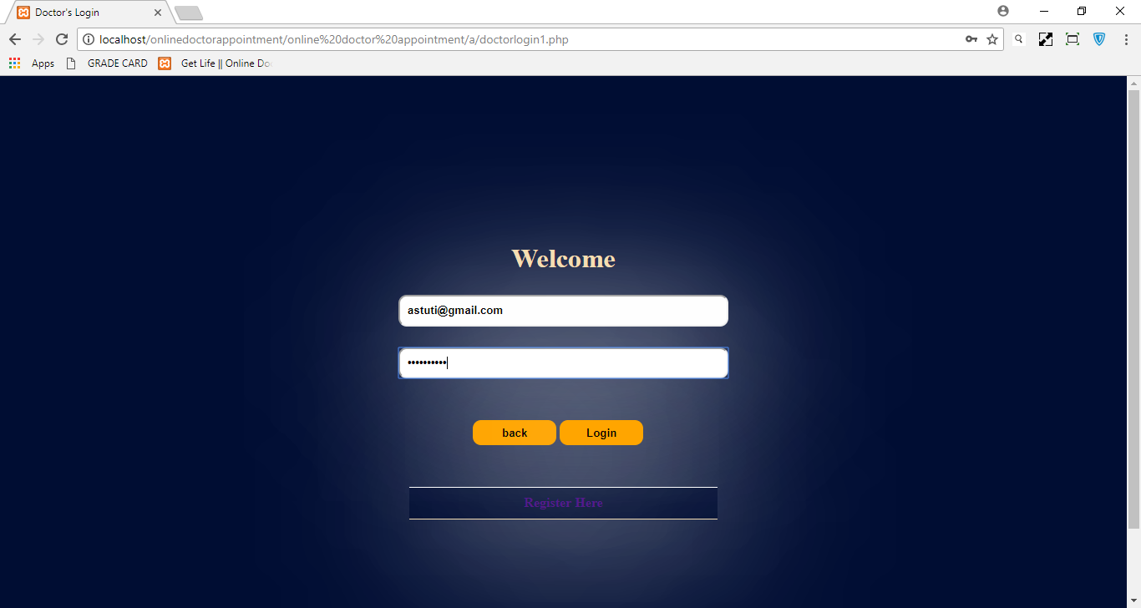

Slide 17
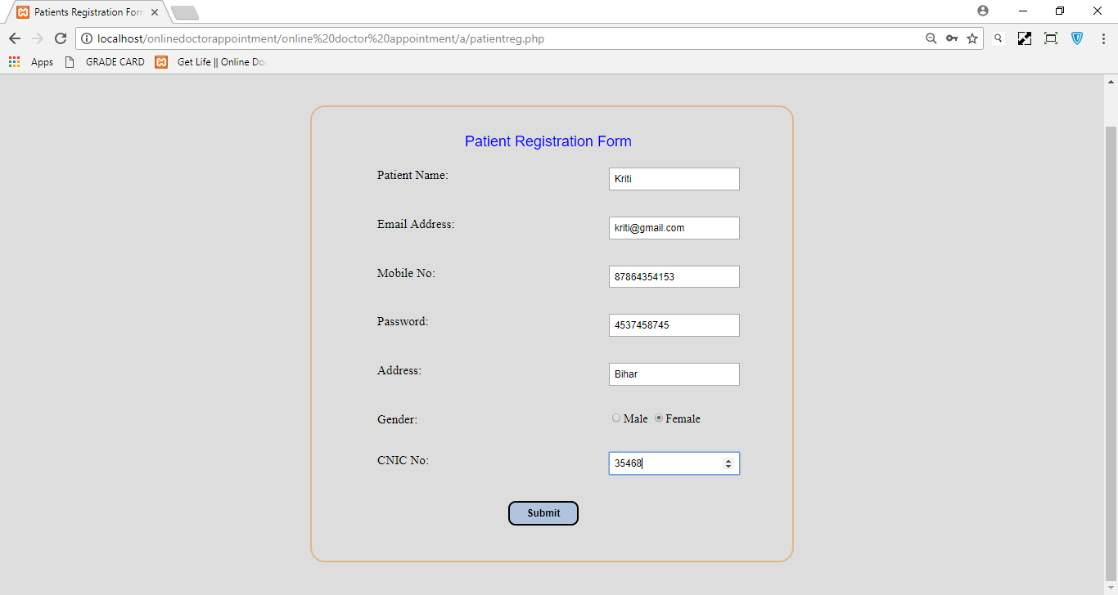

Slide 18
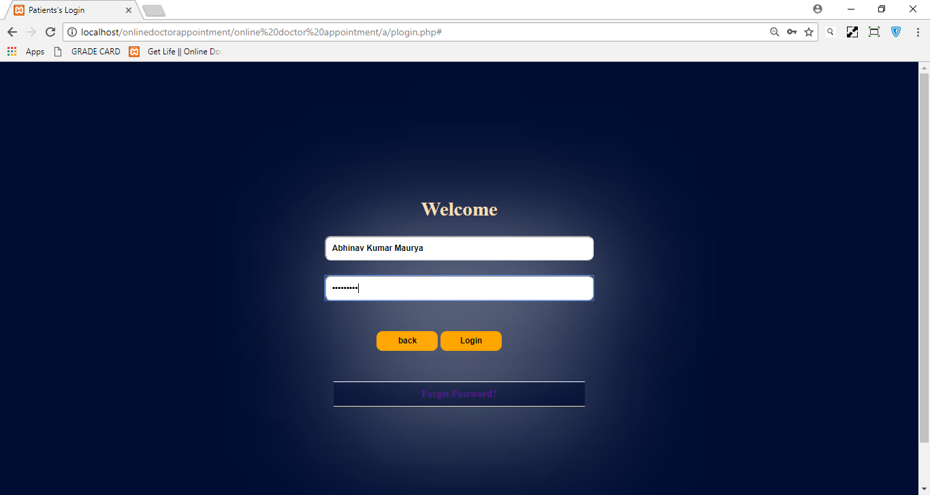

Slide 19

Future Scope of Improvements
Whenever a patient is taking a appointment he/she would get a SMS and a mail using SMTP(SIMPLE MAIL TRANSFER PROTOCOL).
Modifying the Website to an android app for future easy accessible for smartphones

Slide 20
IMPORTANT CODES

Slide 21

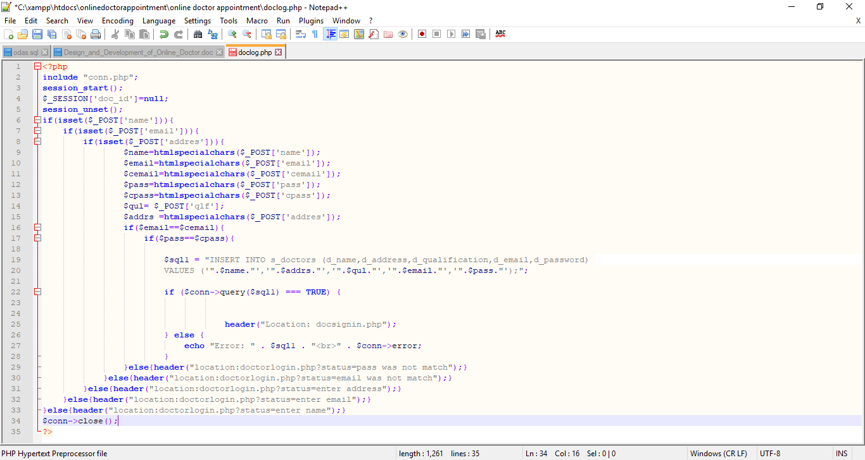
1.

Slide 22
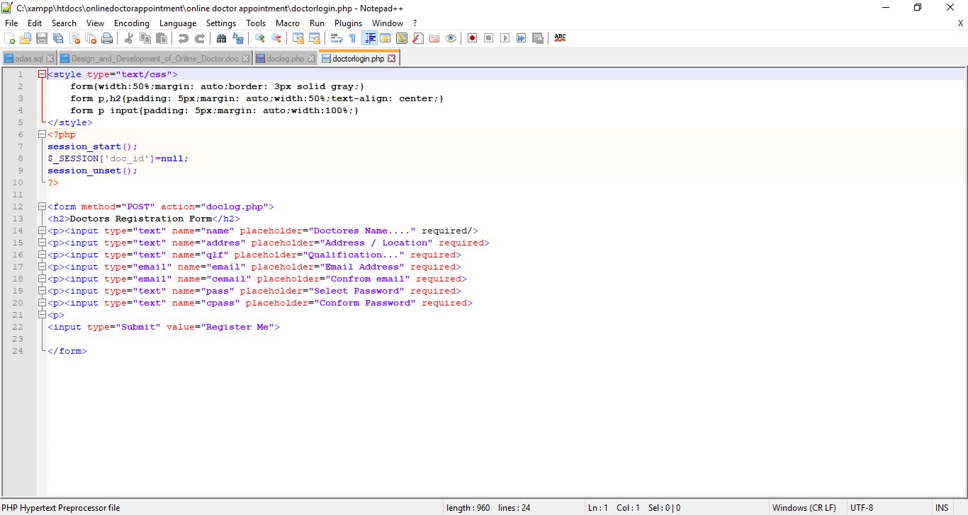
2.

Slide 23
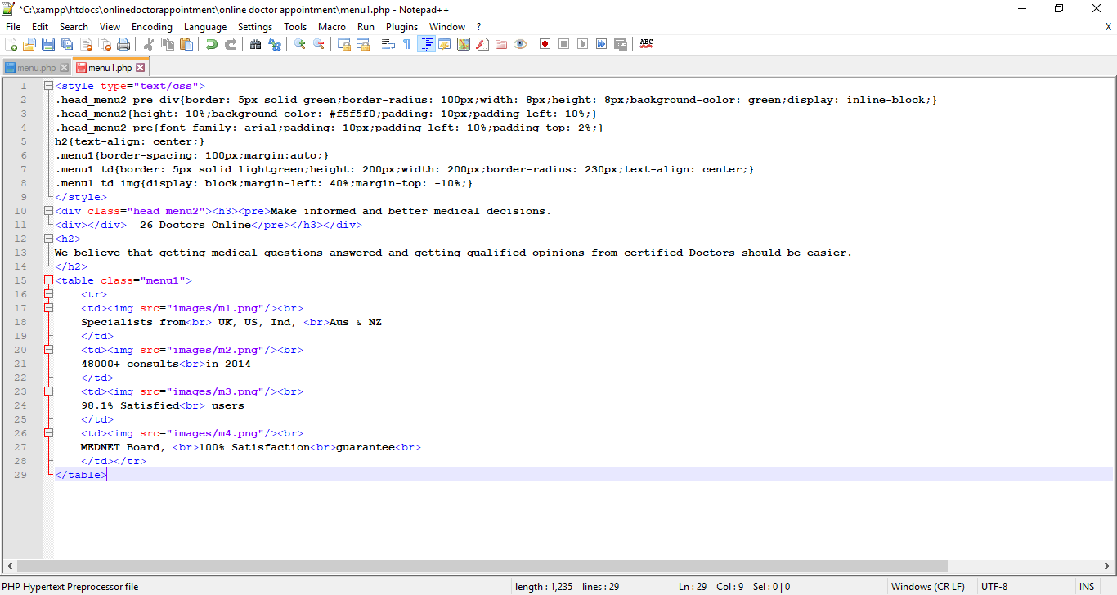
3.

Slide 24
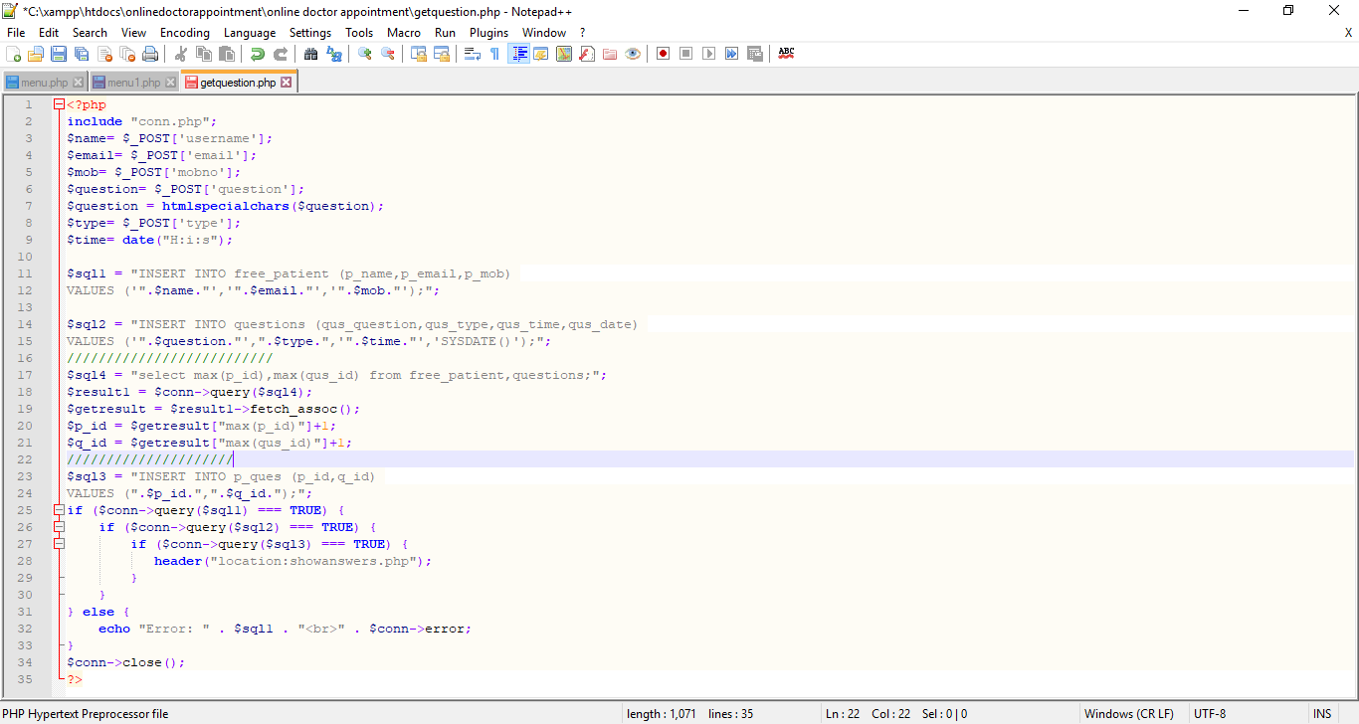
4.

Slide 25

THE END

